Slide 1


Mentorness
Pizza Sales Analysis
By: Aniket Mane

Slide 2

Overview
This project analyzes pizza sales data to extract insights into customer behavior, popular pizza types, and overall sales performance. Utilizing SQL, we query data from four primary tables—order_details, orders, pizza_type, and pizza—to calculate various metrics such as total revenue, the most ordered pizza types, and revenue distribution by hour and category.
Key SQL queries include identifying the top pizza types based on revenue, calculating the cumulative revenue over time, and determining the percentage contribution of each pizza type to overall revenue.

Slide 3
Dataset Information
1. order_details
• order_details_id: Unique identifier for the order detail.
• order_id: Identifier linking to the orders table.
• pizza_id: Identifier linking to the pizza table.
• quantity: Number of pizzas ordered.
2. orders
• order_id: Unique identifier for the order.
• date: Date the order was placed.
• time: Time the order was placed.
3. pizza_type
• pizza_type_id: Unique identifier for the pizza type.
• name: Name of the pizza.
• category: Category of the pizza (e.g., vegetarian, meat, etc.).
• ingredients: List of ingredients used in the pizza.
4. pizza
• pizza_id: Unique identifier for the pizza.
• pizza_type_id: Identifier linking to the pizza_type table.
• size: Size of the pizza (e.g., small, medium, large).
• price: Price of the pizza.

Slide 4
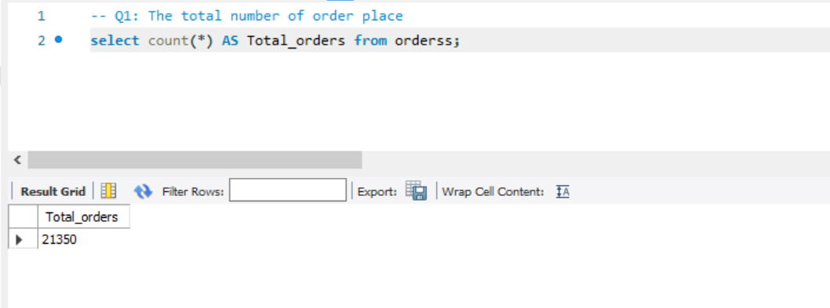
Q1: The total number of order place

Slide 5
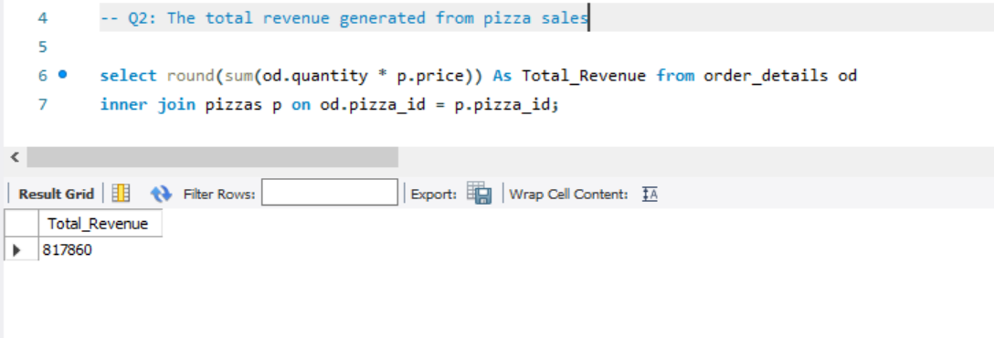
Q2: The total revenue generated from pizza sales

Slide 6
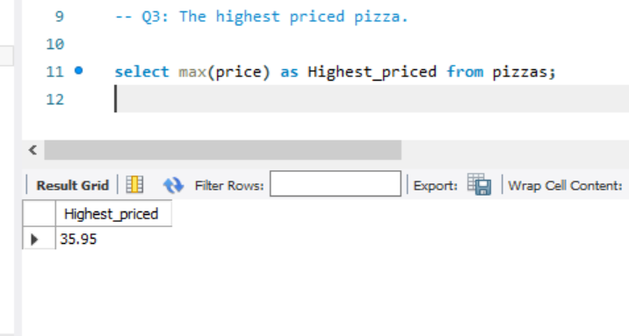
Q3: The highest priced pizza.

Slide 7
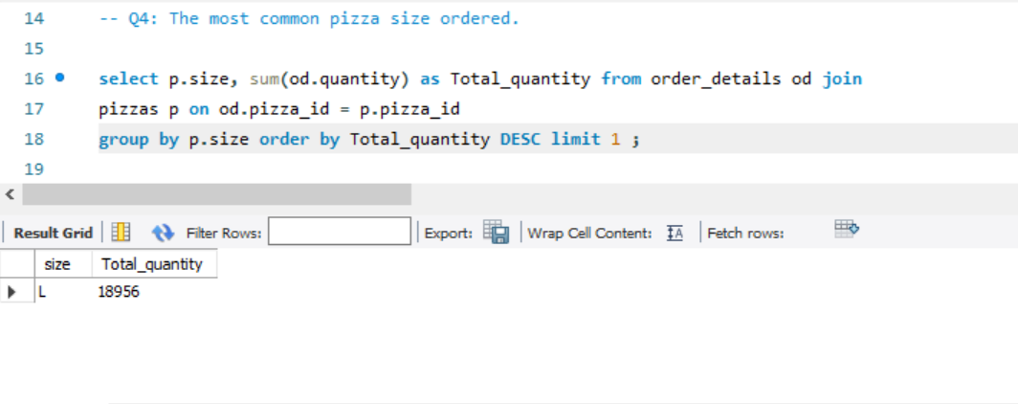
Q4: The most common pizza size ordered.

Slide 8
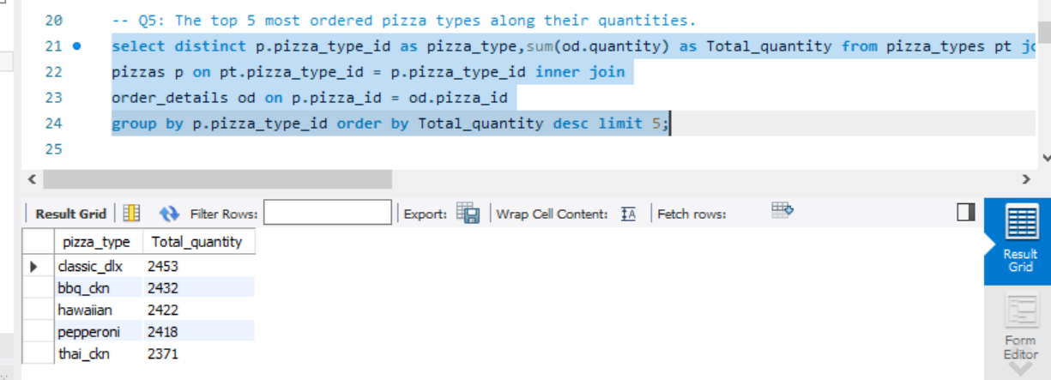
Q5: The top 5 most ordered pizza types along their quantities.

Slide 9
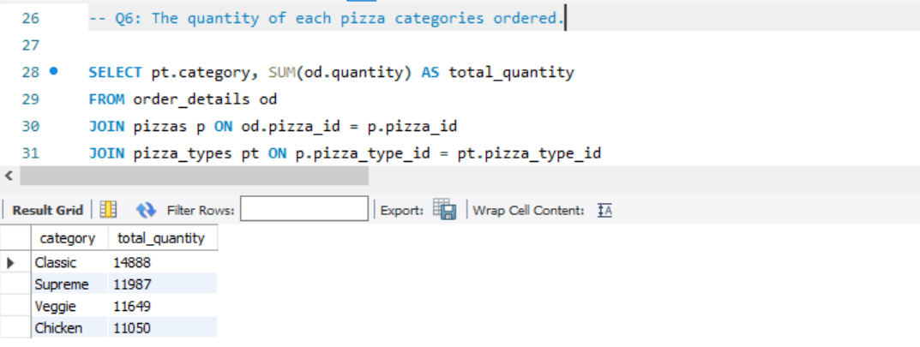
Q6: The quantity of each pizza categories ordered.

Slide 10
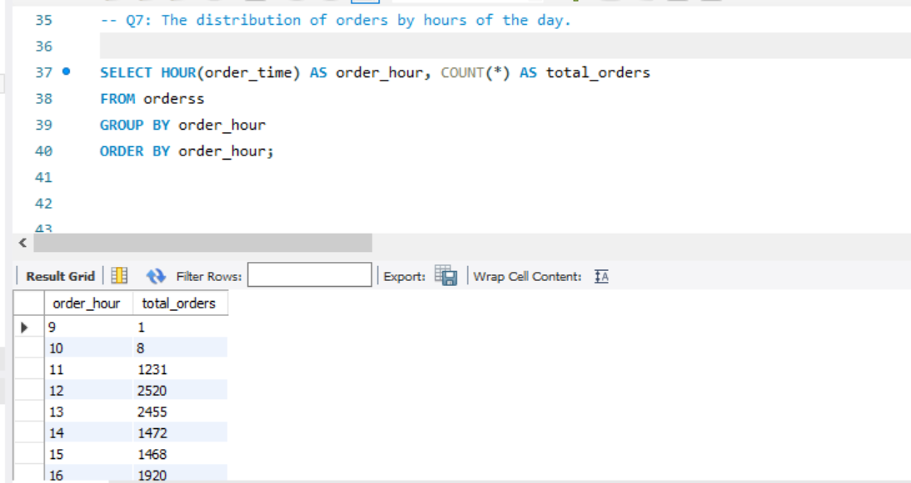
Q7: The distribution of orders by hours of the day.

Slide 11
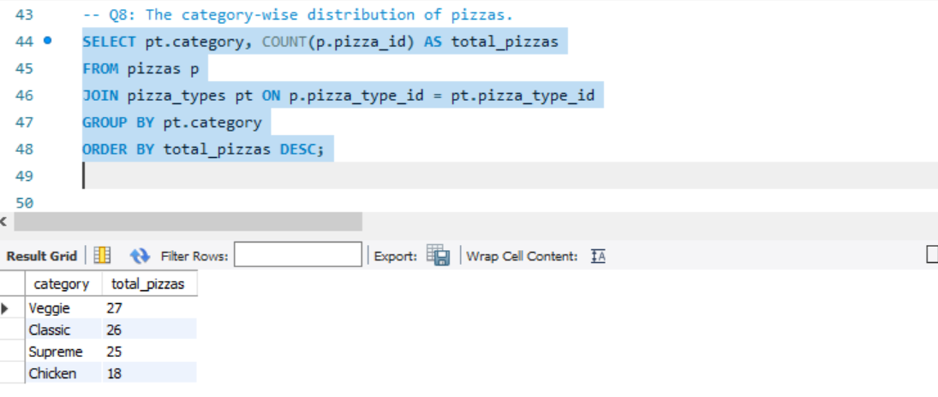
Q8: The category-wise distribution of pizzas.

Slide 12
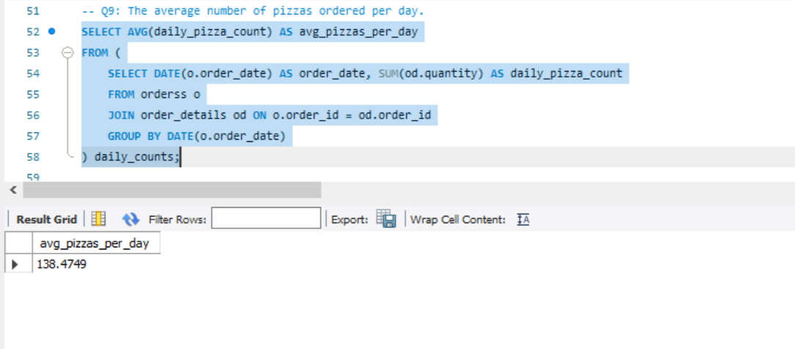
Q9: The average number of pizzas ordered per day.

Slide 13
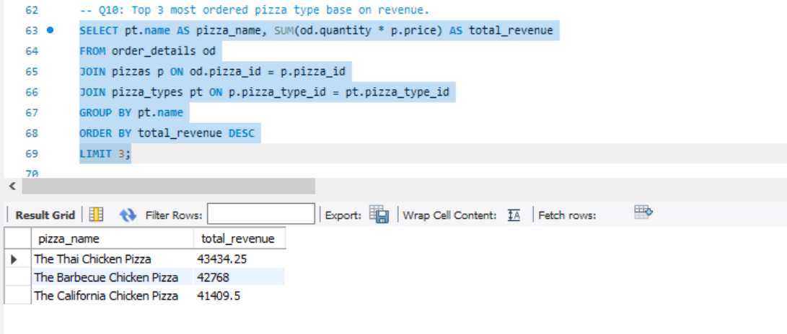
Q10: Top 3 most ordered pizza type base on revenue.

Slide 14
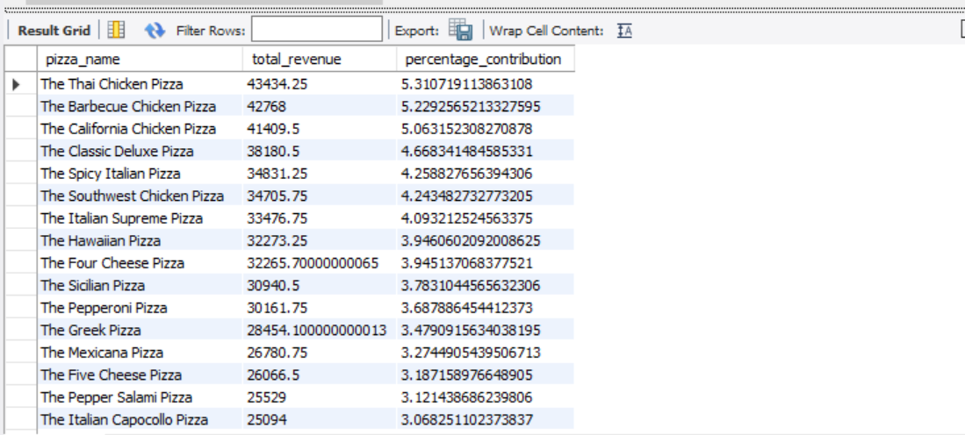
Q11: The percentage contribution of each pizza type to revenue.
SELECT
pt.name AS pizza_name,
SUM(od.quantity * p.price) AS total_revenue,
(SUM(od.quantity * p.price) / (SELECT SUM(od.quantity * p.price) FROM order_details od JOIN pizzas p ON od.pizza_id = p.pizza_id)) * 100 AS percentage_contribution
FROM
order_details od
JOIN
pizzas p ON od.pizza_id = p.pizza_id
JOIN
pizza_types pt ON p.pizza_type_id = pt.pizza_type_id
GROUP BY
pt.name
ORDER BY
percentage_contribution DESC;

Slide 15
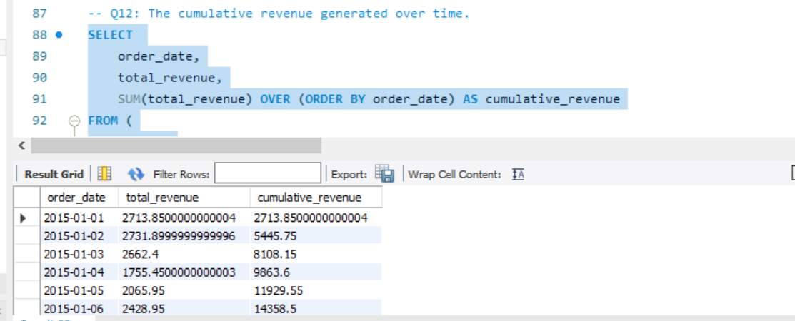
Q12: The cumulative revenue generated over time.
SELECT
order_date,
total_revenue,
SUM(total_revenue) OVER (ORDER BY order_date) AS cumulative_revenue
FROM (
SELECT
o.order_date,
SUM(od.quantity * p.price) AS total_revenue
FROM
orderss o
JOIN
order_details od ON o.order_id = od.order_id
JOIN
pizzas p ON od.pizza_id = p.pizza_id
GROUP BY
o.order_date
) daily_revenue
ORDER BY
order_date;

Slide 16
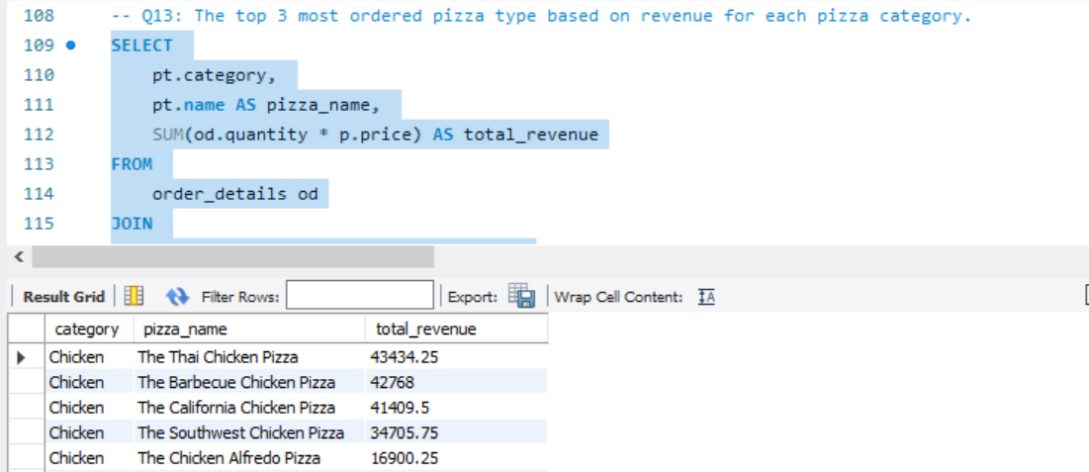
Q13: The top 3 most ordered pizza type based on revenue for each pizza category.
SELECT
pt.category,
pt.name AS pizza_name,
SUM(od.quantity * p.price) AS total_revenue
FROM
order_details od
JOIN
pizzas p ON od.pizza_id = p.pizza_id
JOIN
pizza_types pt ON p.pizza_type_id = pt.pizza_type_id
GROUP BY
pt.category, pt.name
ORDER BY
pt.category, total_revenue DESC;

Slide 17

THANK YOU!
Aniket Mane

